Slide 1
Advanced Machine Learning-based Spectral Unmixing and Super-resolution of Imaging Infra-Red Spectrometer (IIRS) Data:
Presented by: Debesh Maheshwari

Slide 2
Simple Explanation of the Project
This project aims to analyze data from the Chandrayaan-2 mission to study the composition of the Moon's surface. By using advanced machine learning (ML) and deep learning (DL) techniques, the project seeks to improve the accuracy of identifying and mapping different minerals and volatile substances on the Moon. This information is essential for understanding the Moon's geological history and the processes that formed its rocks.

Slide 3
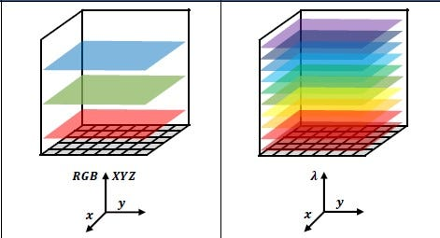
Breakdown of Complex Terms and Concepts
Hyperspectral Image:
As we know the different red,green and blue coloration is due to the fact that the reflected light from objects fall under separate wavelength ranges in the visible spectrum of the electromagnetic radiation, this is all that our human eyes can perceive but there is a lot of wavelengths not covered by the visible spectrum that is easily missed/invisible to our eyes. spectral imaging is the parallel acquisition of spatial and their corresponding spectral information in an image space and their combination thereof.
It is kind of similar to an RGB colour image, but it has a lot more channels and thereby poses a challenge to be visualized as a whole.
For comprehension purposes, let’s say we have a n band hyper-spectral image: it is simply n grey-scale images(each band capturing different light intensity data according to their wavelength values) stacked on top of each other over a contiguous wavelength range- giving us an image of dimension n rows* m columns* n bands.

Slide 4
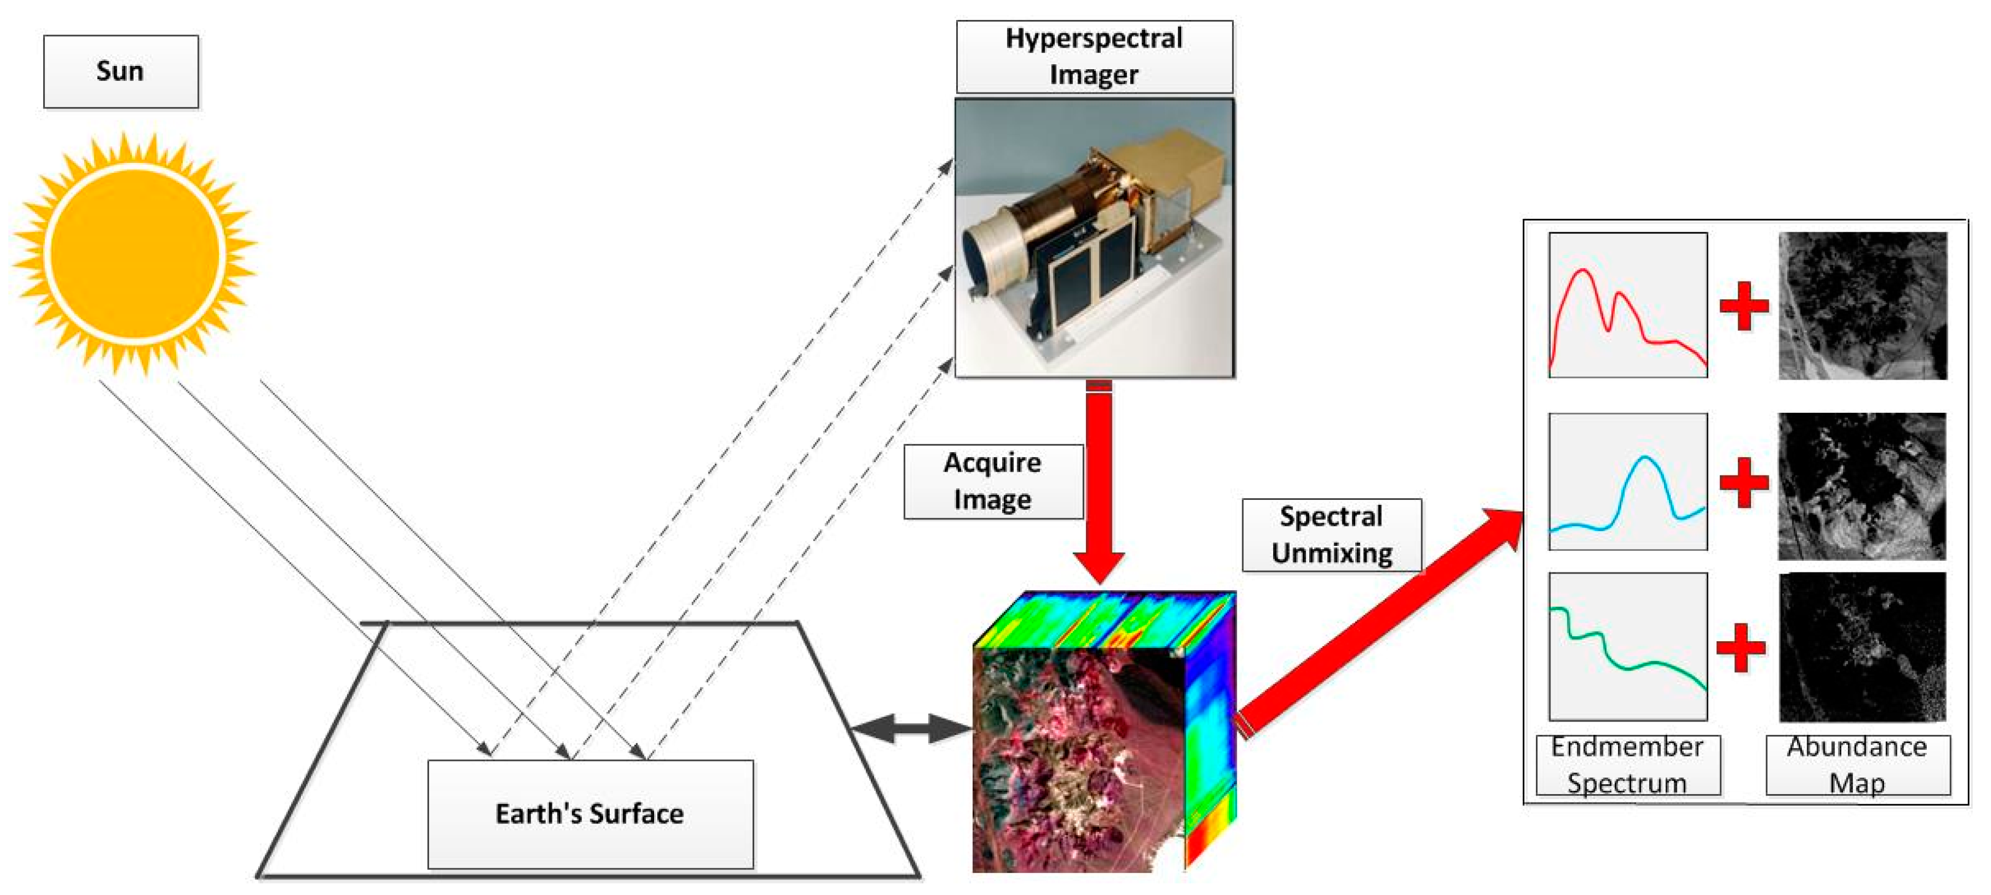
Spectral Unmixing
Pixel spectral unmixing is the process to decompose such a spectrum into a collection of constituent spectra, or endmembers(pure spectral signatures of individual materials in a hyperspectral image.), and their corresponding fractions, or abundances, indicating the proportion of each endmember present in the pixel
Since a single pixel might contain signals from multiple materials (like different minerals), spectral unmixing helps to determine the abundance of each material within the pixel.

Slide 5
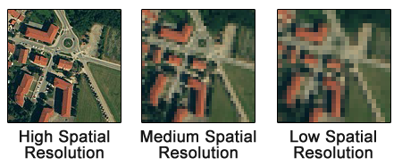

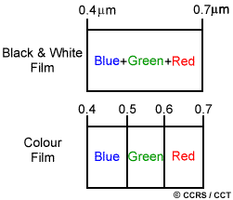
Spectral And Spatial Resolution
Black and white film records wavelengths extending over much, or all of the visible portion of the electromagnetic spectrum. Its spectral resolution is fairly coarse, as the various wavelengths of the visible spectrum are not individually distinguished and the overall reflectance in the entire visible portion is recorded.
Hyperspectral sensors, detect hundreds of very narrow spectral bands throughout the visible, near-infrared, and mid-infrared portions of the electromagnetic spectrum
Spatial resolution is the detail in pixels of an image. High spatial resolution means more detail and a smaller grid cell size. Whereas, lower spatial resolution means less detail and larger pixel size.
Overall, spatial resolution describes the quality of an image and how detailed objects are in an image. If the grid cells are smaller, this means the spatial resolution has more detail with more pixels.

Slide 6
Objectives
Better Image Analysis
Super-Resolution: This technique enhances the spatial and spectral resolution of the images. It allows us to see finer details and distinguish between closely spaced features on the moon’s surface.
Accurate Mapping
Mineral and Volatile Maps: We aim to create detailed maps showing the distribution of different minerals and volatile substances. These maps will help scientists understand the geological processes and history of the moon.

Slide 7
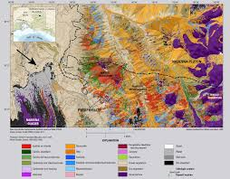
Expected Outcomes
Mineral and Volatile Maps: The developed tools will produce detailed maps showing where different minerals and volatiles are located on the moon’s surface.
Understanding P-T Conditions: These maps will help scientists determine the pressure and temperature conditions that existed when the lunar rocks formed, providing insights into the moon’s geological history.

Slide 8
Conclusion
Advancing Lunar Science: By using advanced ML and DL techniques, we can gain better insights into the moon's surface composition and geological history.
Future Applications: The methods we develop can be applied to other planetary studies, improving our understanding of the solar system.

Slide 9
Thank You

